Slide 1



Book Recommendation System
Group 02

Slide 2





Team Member
Lê Hoàng Khang
Nguyễn Thanh Hùng
Nguyễn Duy Thái
Lê Phước Yên
Write Proposal
Search and collect data
Content-based filtering algorithm
Writing Presentations
Data preprocessing
Collaborative filtering algorithm
Write Report
Search and collect data
Content-based filtering algorithm
Write Milestone
EDA
Collaborative filtering algorithm

Slide 3


Table Of Content
01
REASON FOR CHOOSING TOPIC
MODEL DEVELOPMENT
04
02
EXPERIMENTS AND EVALUATION
05
DATASET
03
06
EDA
CONCLUSION

Slide 4


REASON FOR CHOOSING TOPIC
More Details

Slide 5
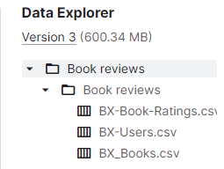

ABOUT DATASET
Link: https://www.kaggle.com/datasets/ruchi798/bookcrossing-dataset
The data set consists of 3 main files containing about 278,858 users, providing more than 1 million ratings on about 270,379 books:
BX-Book-Ratings: includes the user's ID, the code of each book, and the user's rating for that book.
BX-Users: includes user ID, address and age.
BX-Books: includes each book's code, book title, author, year of publication, publisher, summary and link to the book's photo.

Slide 6
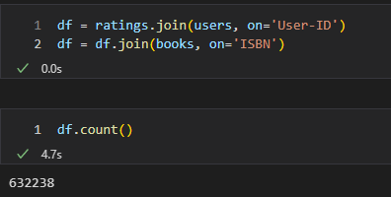
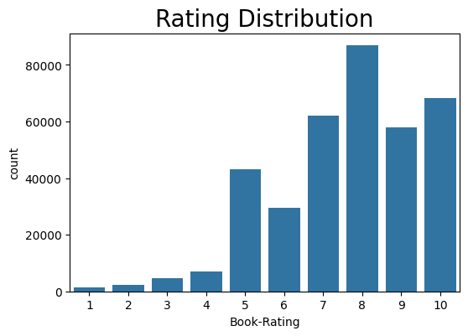
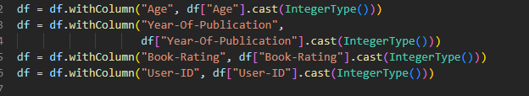

EDA
Join 3 tables
Convert data types

Slide 7
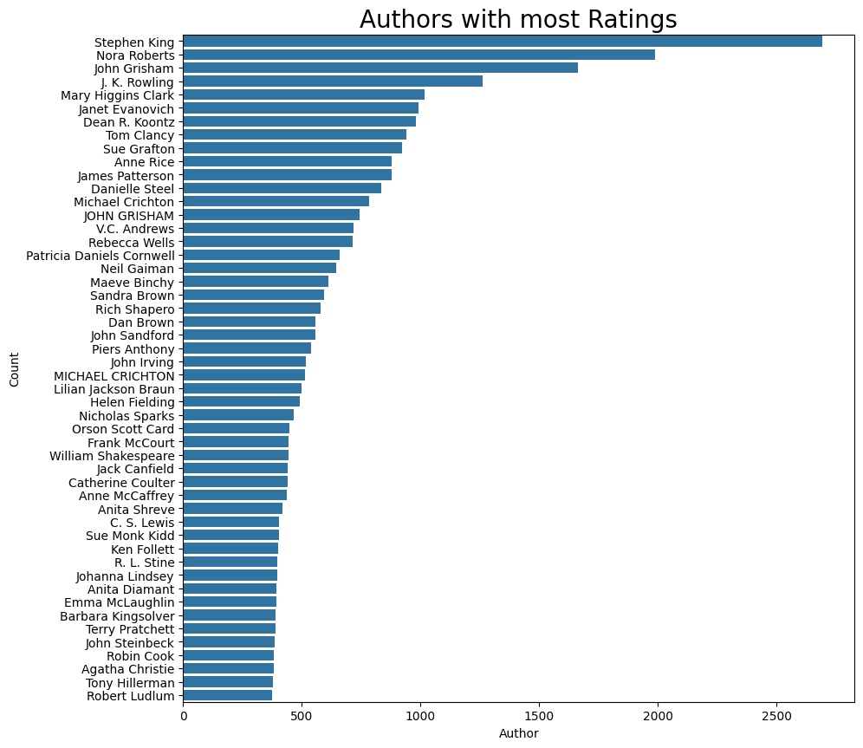
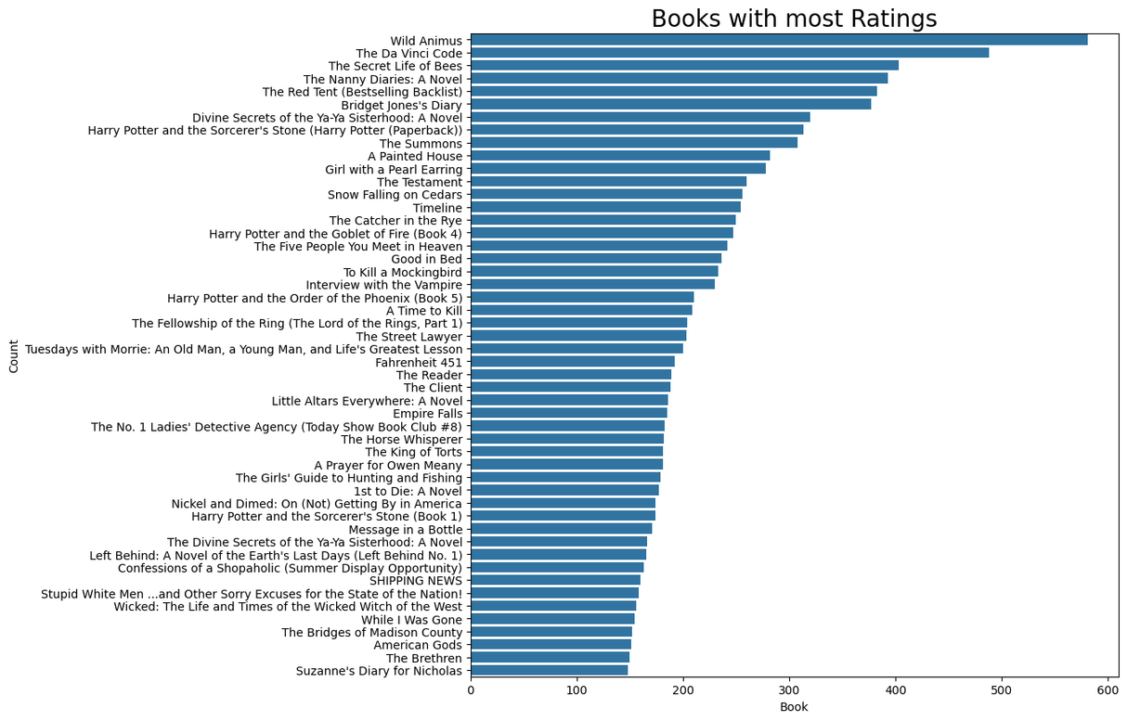

EDA

Slide 8
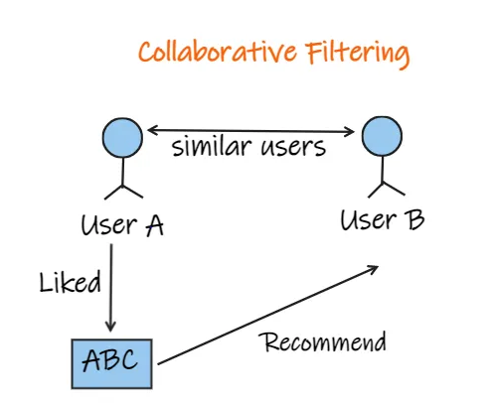
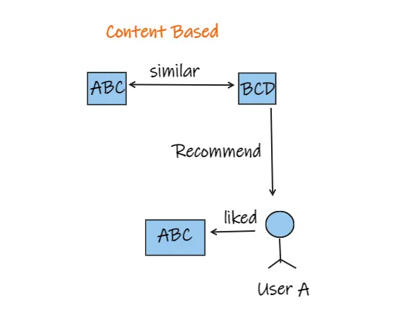

MODEL DEVELOPMENT

Slide 9
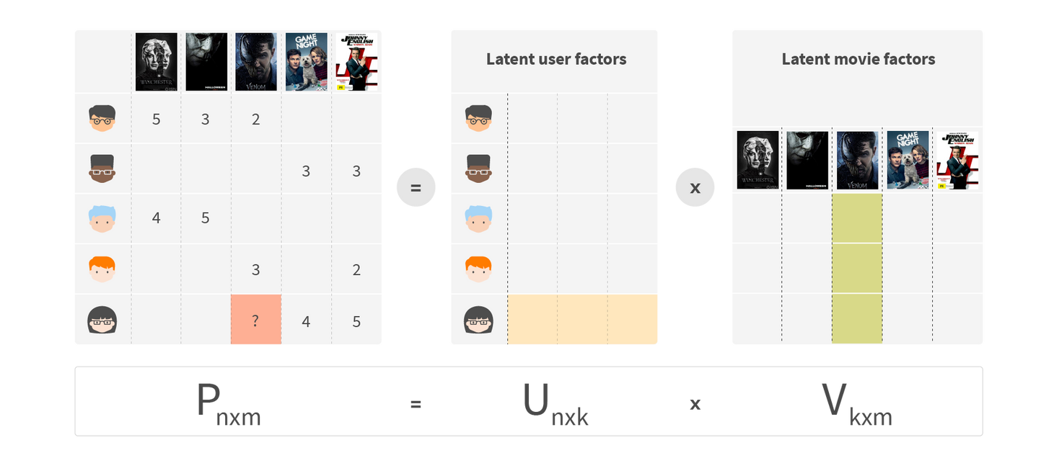
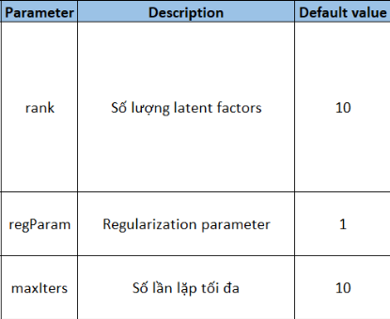

MODEL DEVELOPMENT
COLLABORATIVE FILTERING USING ALS

Slide 10
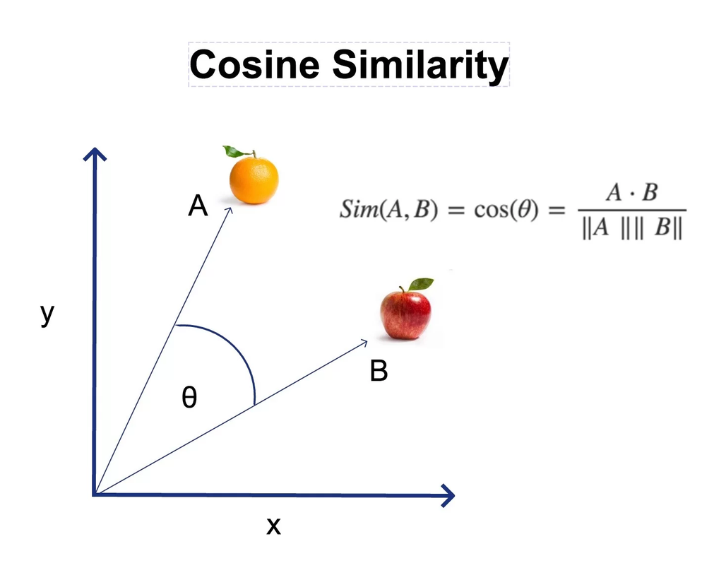


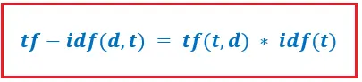

MODEL DEVELOPMENT
CONTENT-BASED USING TF-IDF AND COSIN SIMILARITY

Slide 11
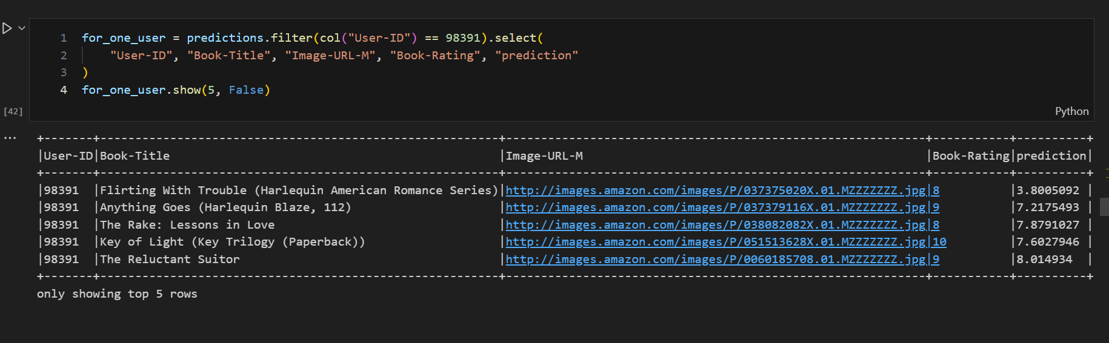
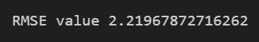

Experiment and Evaluate
Collaborative Filtering

Slide 12
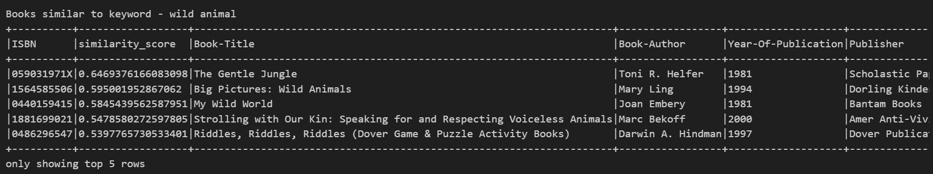
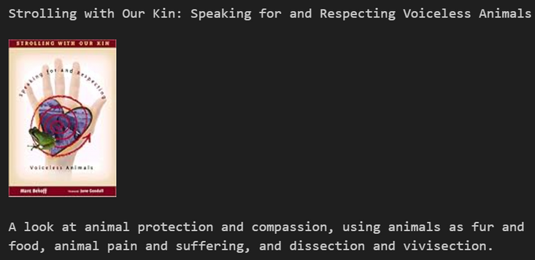
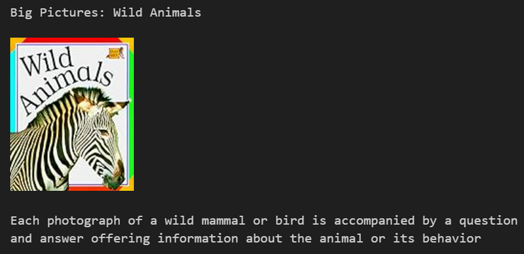
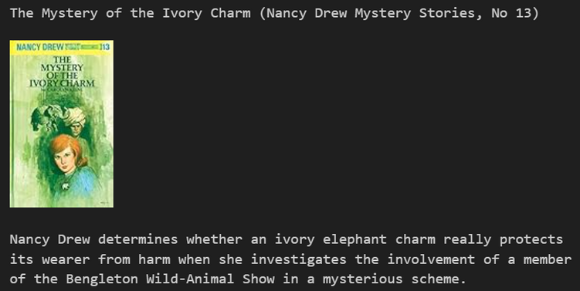
Experiment and Evaluate
Content-Based Filtering

Slide 13

Conclusion and development direction
Conclusion
Through the process of implementing the project, the group learned more knowledge about recommendation models using PySpark for book suggestions.
Overall, the topic has completed the basic level, providing suggestions based on user preferences and entered keywords.
Development direction
Perform suggestions with large amounts of data
Combine interfaces to be more intuitive
Process automation

Slide 14

Thanks

